Slide 2
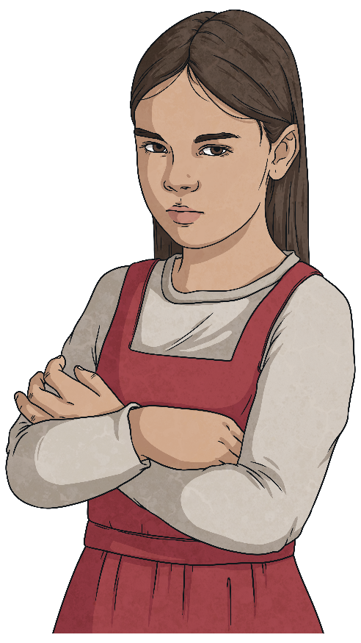
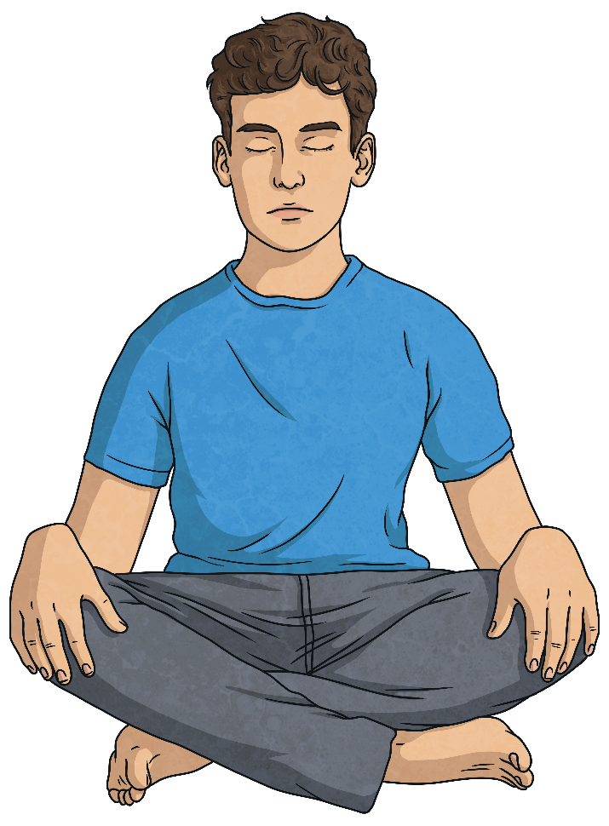
PSHE and Citizenship Scheme of Work
Twinkl Life's PSHE and citizenship scheme of work is designed to support children develop the essential skills they need to:
stay physically and mentally safe and well;
build healthy, successful relationships;
become active, responsible members of society.

Slide 3
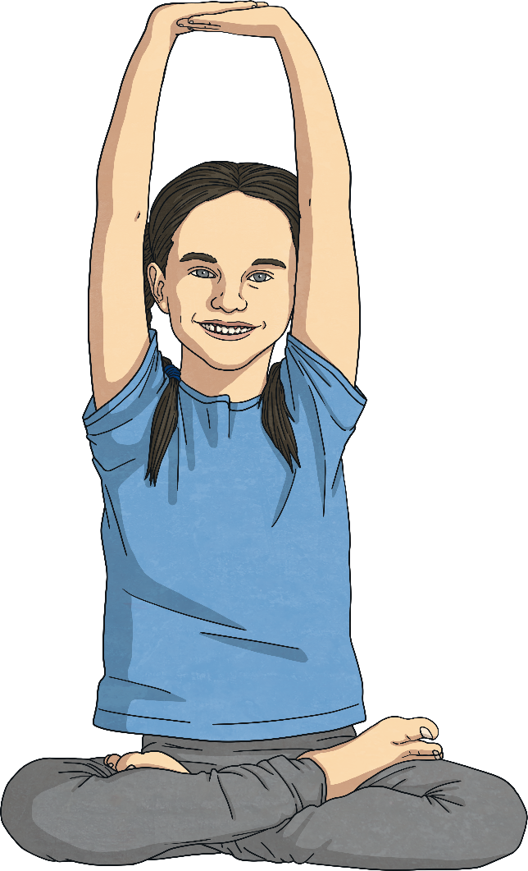
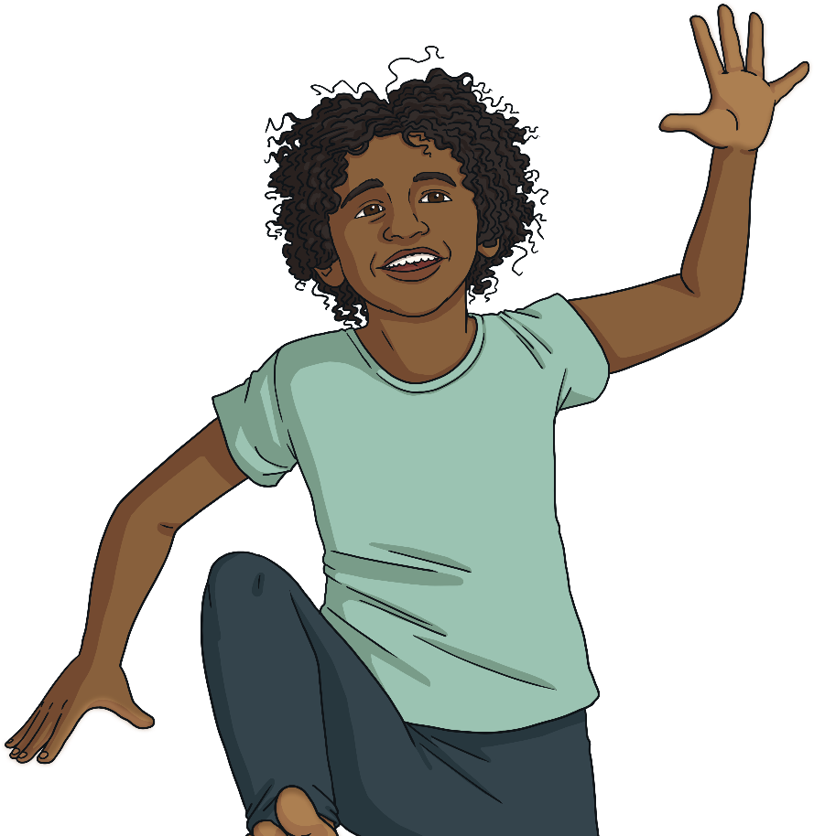
PSHE and Citizenship Scheme of Work
This scheme of work covers the statutory objectives for health and relationships education as well as content on digital literacy and financial education. The scheme is designed to provide a spiral curriculum, revisiting topics in an age-appropriate way in each phase to develop and deepen children's understanding of concepts and content.

Slide 4
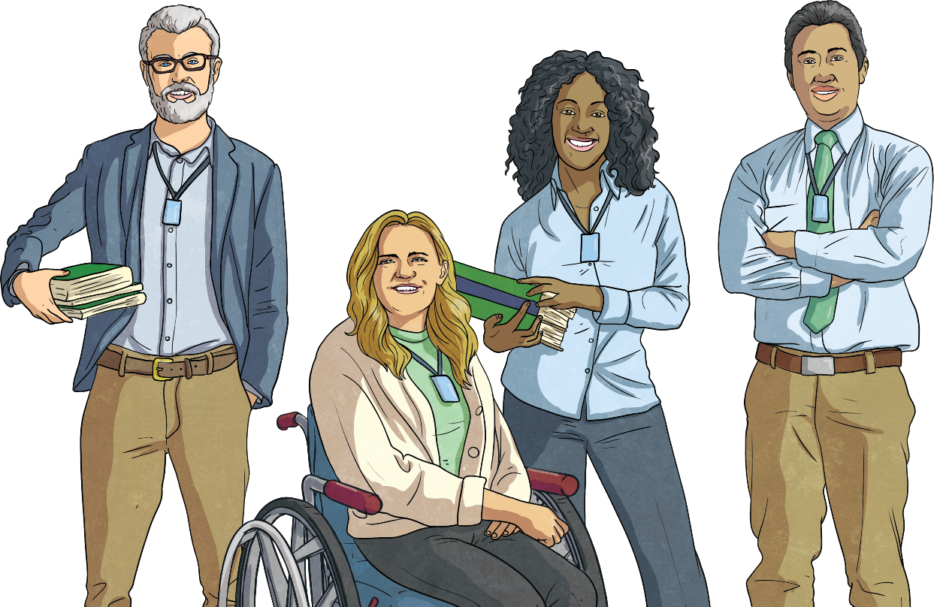
PSHE and Citizenship Scheme of Work
PSHE teaching is most effective when delivered by the regular class teacher in timetabled weekly lessons. This way, sequences of lessons can ensure depth of coverage, enabling educators to plan and start from where children's understanding currently is, be aware of and plan for sensitivities that may be present in the class and effectively assess children's progress after each lesson and unit. When planning and delivering these units, it is very important to be mindful to create a supportive and secure learning environment and to set ground rules for discussion, decided on as a class.

Slide 5
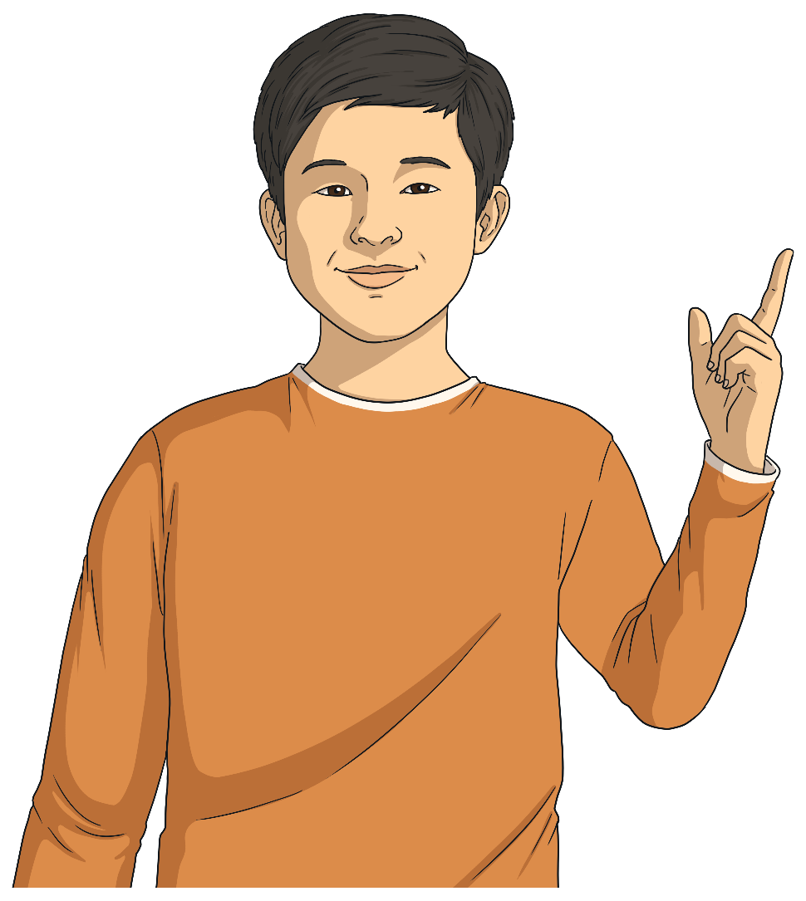
PSHE and Citizenship Scheme of Work
This resource outlines a possible sequence of teaching for units in the scheme. This is one possible format but the scheme is designed to be flexible and used in the way that best suits the needs of the school, class and staff. Therefore, please use it in a way that works best for your learners.
Included on the following slides is the suggested sequence for each unit from PSED in nursery and reception and units in KS1 and KS2. All the units are designed to be flexible so there is no requirement to teach them in this order - it is purely one option for sequencing. Included in the PSED progression grid are references for units within the KS1 scheme that follow on most closely from each topic.

Slide 6
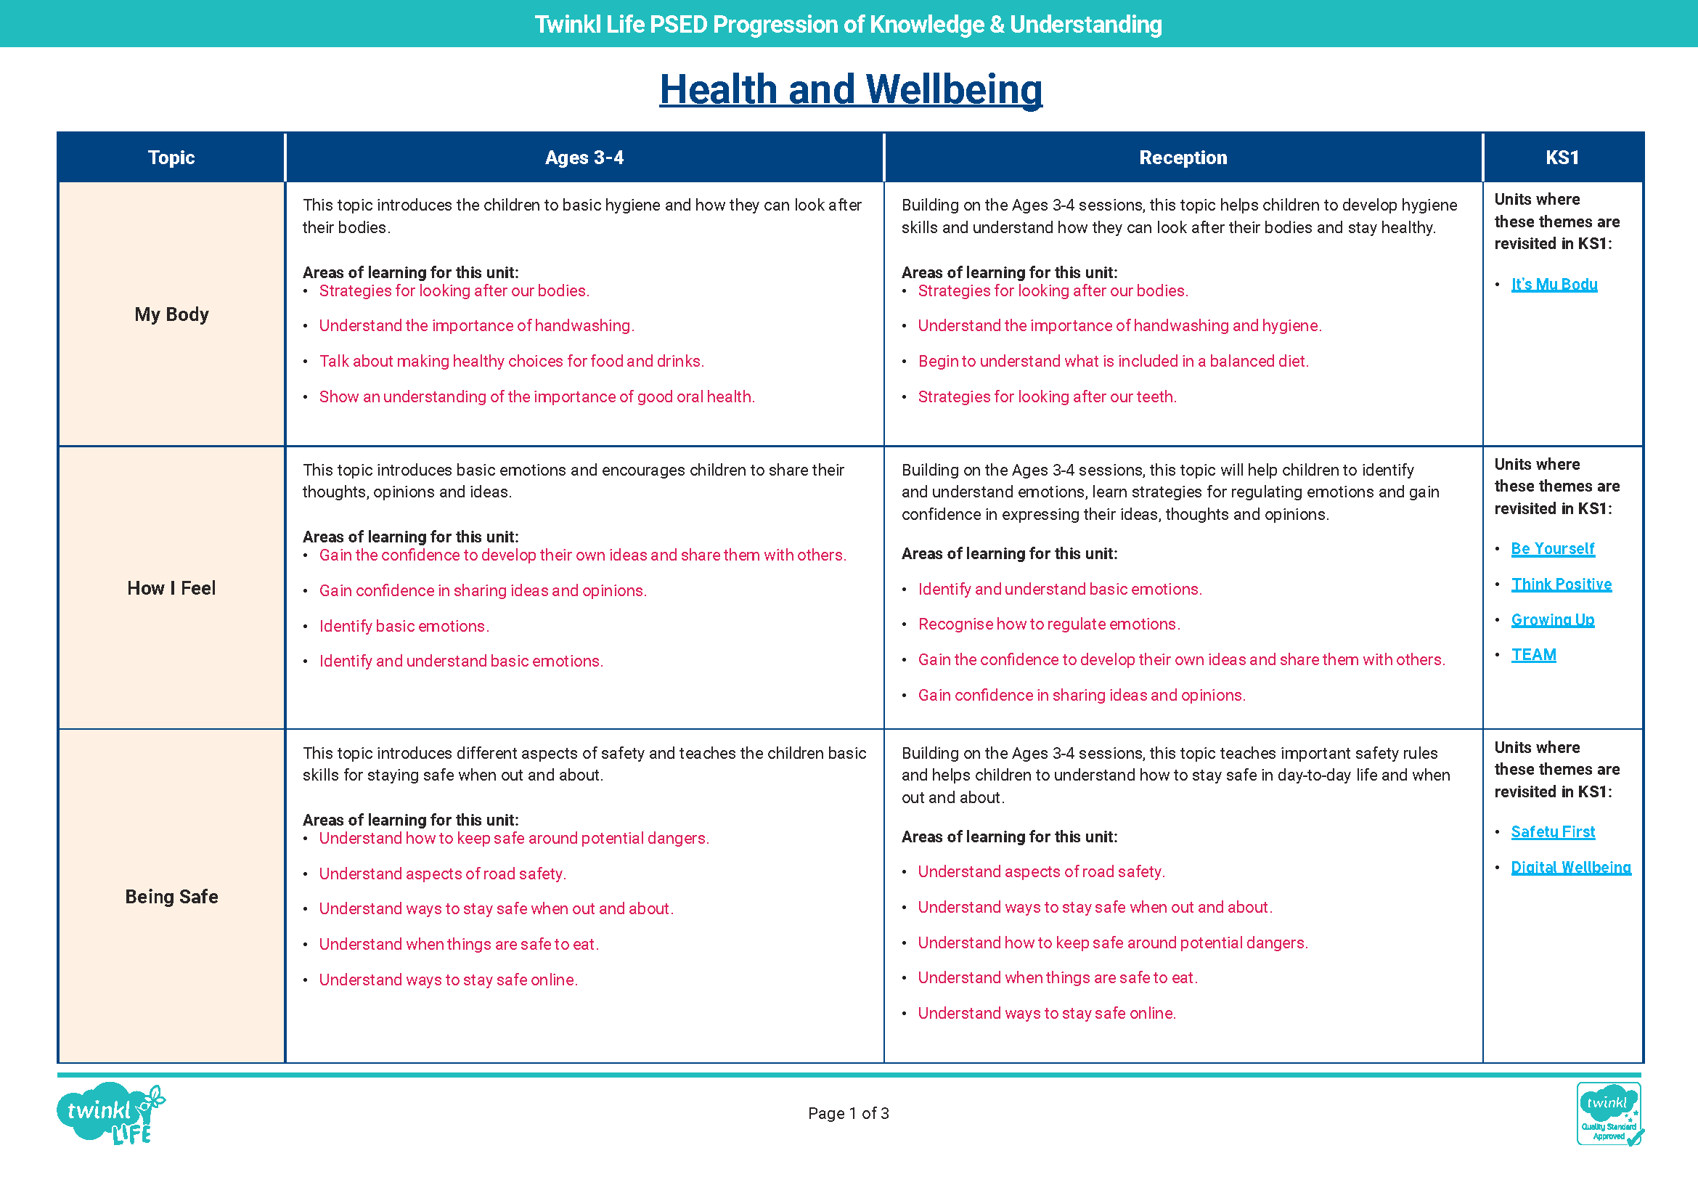
Twinkl Life PSED Progression of Knowledge and Understanding

Slide 7
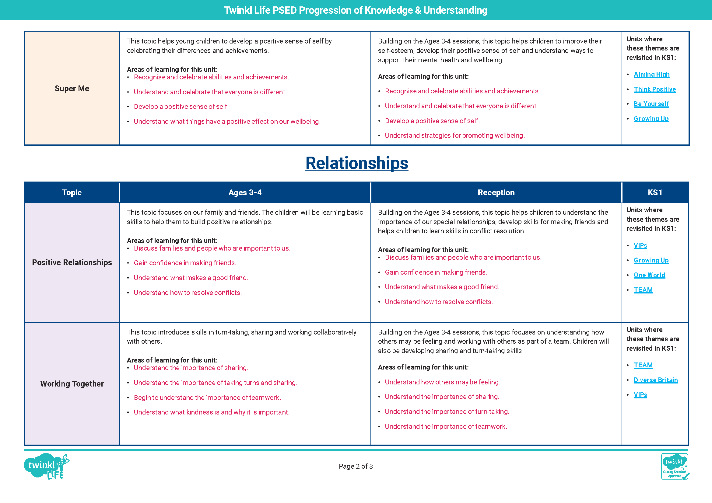
Twinkl Life PSED Progression of Knowledge and Understanding

Slide 8
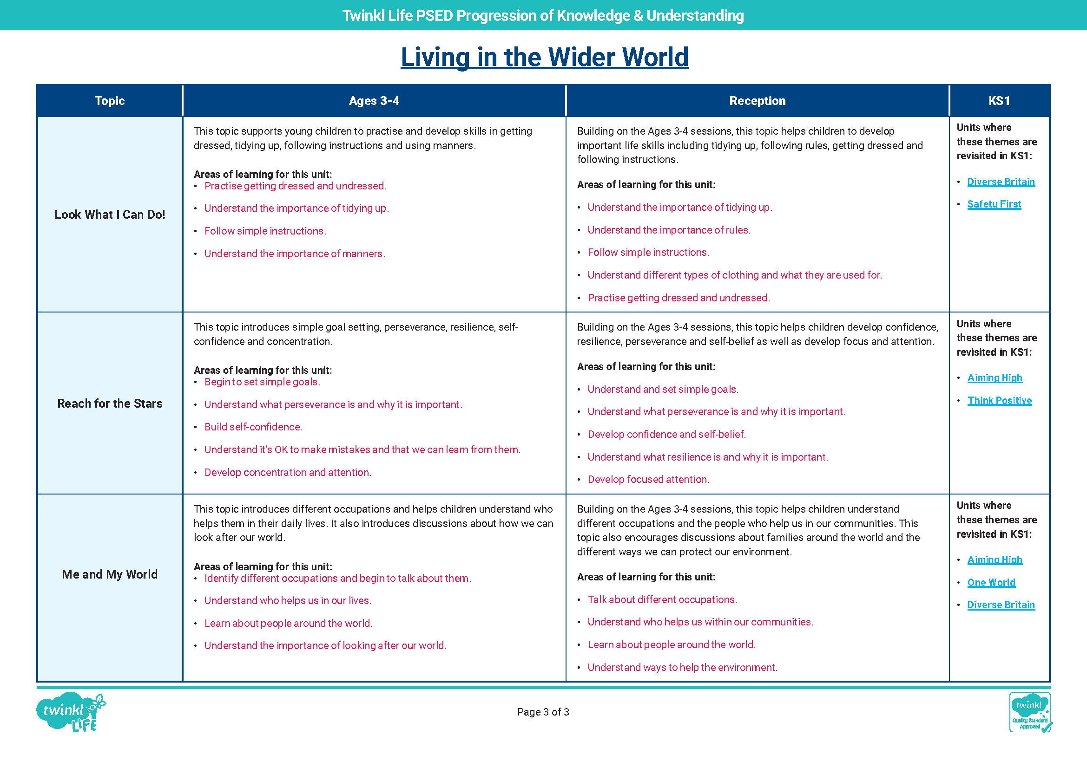
Twinkl Life PSED Progression of Knowledge and Understanding

Slide 9
PSHE and Citizenship KS1 and KS2
 | Autumn 1 | Autumn 2 | Spring 1 | Spring 2 | Summer 1 | Summer 2
Year 1 | Be Yourself | Safety First | Diverse Britain | VIPs | It's My Body | One World
Year 2 | TEAM | Think Positive | Money Matters | Digital Wellbeing | Growing Up | Aiming High
Year 3 | Be Yourself | Safety First | Diverse Britain | VIPs | It's My Body | One World
Year 4 | TEAM | Think Positive | Money Matters | Digital Wellbeing | Growing Up | Aiming High
Year 5 | Be Yourself | Safety First | Diverse Britain | VIPs | It's My Body | One World
Year 6 | TEAM | Think Positive | Money Matters | Digital Wellbeing | Growing Up | Aiming High

